Slide 1
China 1928 - 1934

Slide 2
April 1928 – Second Northern campaign to go further North and capture Beijing started with Chiang Kaishek in charge.
Chiang had made an alliance with two Northern warlords Feng Yuxiang and Yan Xishan. This allowed him to defeat the most powerful warlord Zhang Zuolin, the ruler of Manchuria.
Zhang Zudin was killed in a bomb explosion and his son was murdered.
Guomindang was now the most powerful force in China . The Capital transferred to its base in Nanjing
The National Government set up with a council of Satate to rule headed by Chiang Kaishek.

Slide 3
Reality
China was not really united
Northern warlords never fully accepted his authority
Rebelled 1929 – Civil War and it became a battle between Feng and Yan v Chiang
It was difficult to rule due to size, gangs of bandits traumatising whole districts.
Survivors of communists explosions retreated to Jiangxi province and set up a Chinese Soviet Republic called Jiangxi Soviet and Mao Zedog was their political leader. Zhu De was their military leader. De had gained support bu dividing up land among the farming population, abolished arranged marriages and created Peasant Councils.
Chiang also saw Jiangxi Soviet as a threat so he organised elimination campaigns against them between 1930 -1934.
Armies outnumbered soviets but the campaign failed due to the use of guerrilla warfare tactics. However, this allowed Chiang to capture communist villages ad 1,000,000 peasants died as a result of attacks and starvation
Many criticised Mao’s tactics.

Slide 4
The Long March – Background
This was the 5th Campaign – Chiang ‘blockaded’ the communists by surrounding the Jiangxi province with 500,000 troops, then advanced by building blockhouses (concrete shelters) and digging trenched. By October 1934 – the Communists lost half of their territory and 60,000 Red Army soldiers killed.
The Communists responded with new tactics suggested by Otto Braun, a Russian agent. His tactics included that it was politically wrong to let peasants to be captured and killed and also that it was important to defent the borders by fighting head on battles.
Mao was also expelled from the Central Communist parties. Braun was also in charge of the Red Army at this time.

Slide 5
The Long March
16th October 1934, 78,000 Red Army soldiers retreated, taking with them everything they needed to set up a new government in Huan-Hubei. Examples, radio equipment, furniture, gold bars, printing press and weapons.
6 weeks to break through the blockhouse – Major battle Xiang River (25th Nov to 3 Dec). 45, 000 lost, Bruan blamed as the heavy equipment make it hard for them to move quickly. They also marched in a straight ling which also made it very easy for Guomindag to attack.
9th January 1935 the Red Army reached Zunyi and control was given back to Mao and Zhu De.
The new direction/leadership was now adopted by the army, where they twisted and turned their route and changed their destination to the Shaanxi province.
Many obstacles were now in their way, the Dudu river (while crossing 22 soldiers had to swing across over the gorge on chains while under fire).
They also had to pass over the Snowy Mountains and through treacherous grasslands where hundreds drowned in deep marches.
In October 1935, the Red Army reached Yanan. They had marched/ travelled 9000km over 368 days, exposed to hunger, accidents and many deserted.

Slide 6
To a united front 1931-7
Japan had seized Manchuria from China’s control but they wanted more territory in the country. In 1933 the Kwantung Army occupied the province of Rehe and started to advance southward. By the end of 1936 they had taken control of considerable areas of China. They were also demanding a separation of North and South China.
The invasion of Japan and their success in taking territory only added to the already strong anti foreigner feelings. This was now strongly directed at Japan and in the main ports, such as Shanghai, boycotts of Japanese goods were organised.
Many Chinese people wanted Chiang Kaishek to declare war on Japan, however he did not agree with this. He believed that China had to be a strong united country before a war could be declared, and that they could only be strong and united under the rile of the Guomindang and wipe out all Communist influence.
The Communists wanted to fight Japan and said that all China should unite to fight the common enemy. Their slogan was “Chinese do not fight Chinese” helped strengthen their case and also the Long March had brought them to areas where Japan was in power and they had some influence there, hence were in a strong position to attack Japan.

Slide 7
Yet another extermination campaign, 1936
Chiang Kaishek ignored the demands of the Communists to form a ‘united front’ and in 1936 he organised another extermination campaign against the Communists. This was to be based in the North East of the country, Xian, in Yanan.
One big problem with this campaign was that the Manchurian troops, who were the majority of the army, wanted to fight the Japanese and not other Chinese/ Communists. Their leader, Zhang Xueliang, also wanted revenge against the Japanese as they had murdered his father.
In 1936 Zhang and the Communists made an unofficial agreement not to fight each other and instead they would concentrate on attacking Japan.
In December 1936, Chiang found out about this agreement ad went to Xian to speak to Zhang to convince him to carry out the extermination campaign against the Communists.

Slide 8
The Xian Incident, Dec 1936
Shortly after his arrival to Xian, Chiang was taken prisoner by Zhang. 200 of Zhang’s troops and Zhang himself stormed the hotel that Chiang was staying in and while Chiang initially escaped, he was soon captured.
Zhang’s troops kept Chiang prisioner for over two weeks and during that time long discussions were help between representatives of the Guomindang,the Communist Party and the Russian government. They eventually agreed to release Chiang.
In return for his freedom, Chiang agreed to a united front with the Communists against the Japanese and the Russian government would supply military aid to help in the fight.
This decision was very well timed as July 1937 saw the Japanese declare war on China, this time to take control of the whole country.

Slide 9
The JAPANESE – CHINA WAR 1937-45
In July 1937 the Japanese provoked local Chinese troops into a fight on the Marco Polo Bridge outside Beijing. Claiming that the Chinese had fired the first shots, the Japanese had no other choice but to declare war on China.
Japanese troops swept southwards, pushing back the Guomindang armies and after a violent campaign for three months they managed to seize Shanghai (China’s most important port). Soon after this they managed to capture Nanjing, the capital and this forced Chiang to retreat.
By the start of 1938, apx 1 million Japanese troops were in China and had control of the main cities and lines of communication around the mouth of the Yangzi River, China’s most fertile and densely populated area.
Later in the year they advanced to take control of Wuhan and Guangzhou cities and the island of Hainan.
For the next five years, the Japanese did not make many more advancements as they did not have the manpower to continue their conquest of a country considerably larger than them.
Many of the areas that the Japanese once had control over, they had moved out of to focus on other areas. China used this to move back into these areas and regain control.
From 1938 Japan had occupation of the large cities, important railways, airfields, ports and roads. The Chinese had control of the countryside.
Japan was also focused on destroying Chiang;s wartime government in Chongqing using a bombing campaign. This city became known as the ‘most bombarded city in the world’.

Slide 10
American Involvement
By 1941 Japan had around 2 million men in China, which was more than half of her entire armed forces. However, things started to work in Chiang and China’s favour in December 1941 when America declared war on Japan (Pearl Harbour attack).
An immediate result of the American influence was the influx of arms into China and the building of American airfields in China to be used against Japan.
In April 1944, the Japanese launched a new attack on South-East China to destroy the American airfields. While this was a success, they suffered losses elsewhere and by the summer of 1945 the war suddenly ended – America dropped two atomic bombs on Japan causing huge damage both physically and psychologically.

Slide 11
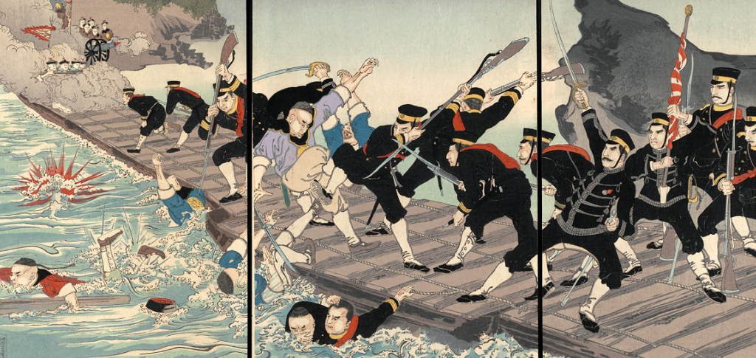
The people at war
For millions of people the war in Japan was a time of huge cruelty against them. Japanese forces acted with great savagery from the very start looting, rape, torturing, murder and needless destruction.
In the eight years of war between China and Japan, apx 4 million Chinese were killed and a further sixty million made homeless.

Slide 12
The Communists at war
The only group of Chinese who came out of the war stronger was the Communists. They took the conflict as a time where they grew their influence in the areas where they had control.
With such strong control, once the war was over, the Communists would be able to step in after the was and take control.
From 1937 to 1940 Communist fighters gradually moved eastwards from their base at Yanan and took control in many areas in North China.
In 1940 they began an offensive called the Hundred Regiments Battle in which they attacked Japan’s railway communications through North China, paralysing Japanese traffic to and from the south.
To deal with the threat from the Communists the Japanese began an operation in 1941 which they called the Three All Campaign – kill all, burn all, destroy all. Their aim was to turn the people against the Communists in areas which supported them, by burning down their villages and crops, slaughtering their animals, poisoning their wells and murdering their peasants.
This campaign had the opposite desired affect, the peasants became more willing than ever to turn on the Japanese and help the Communists to attack them.
In 1945, as the Japanese withdrew from southern China back to Manchuria, the Communists were able to advance into areas that they had left and their influence continued to grow.

Slide 13
The fight for china – Communism v guomindang
At the end of the war 1945, both the Communists and the Guomindang intended to take control of China.
They had very different leadership ideas. Chiang believed that it was best to lead China like the Fascist leaders of Europe. He wanted to be known as the ‘Generalissiom’ and he had a private army of Blueshirts to help enforce his rule. Their main aim was to hunt down Communists and rid the country of them.
Chiang believed that by leading the country this way he would be able to modernize the country, unify the country and improve communication and transport.
Chiang introduced the New Life Movement to help achieve his ideas of National Unity. This movements focused on courtesy, service, honesty and respect and finally high mindedness and honour.
This movement put a lot of stress on the public health, self discipline and honesty. Posters and slogans were spread throughout the country. Some posters even instructed the people how to clean and blow their noses correctly.

Slide 14
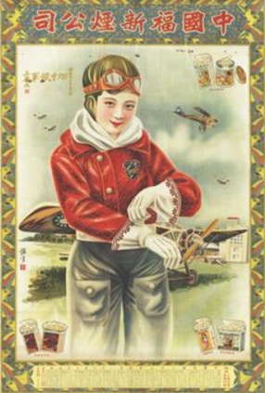
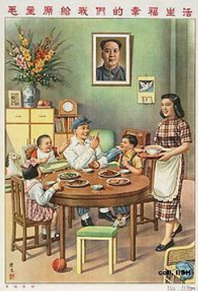
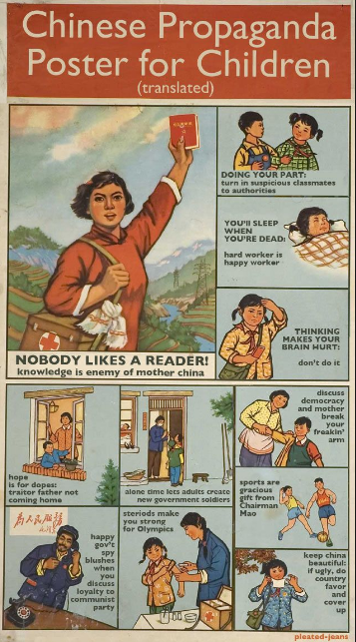
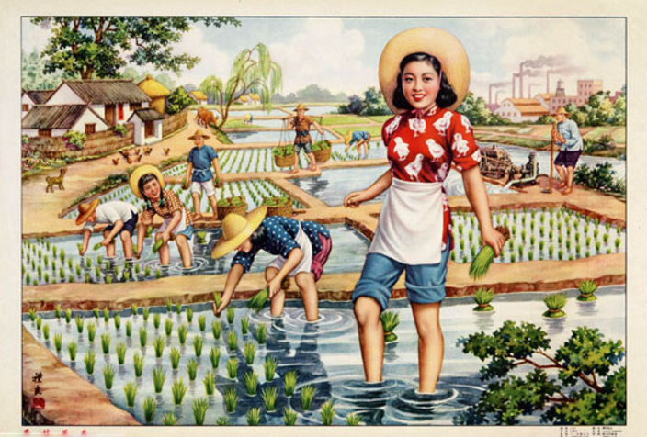

Slide 15
Another movement that Chiang started was the Rural Services. This was a government organisation which sent students into the countryside during the holidays to help the peasants with the harvest of the crops.
But nothing was done to reduce land taxes which took half of their income. Nor he was able to prevent the famine in 1929-32 from killing more than three million.
Chiang and the Guomindang never gained any support from the peasants, who held the majority of the populations. The areas where the Guomindang were popular were the towns and cities of eastern China (middle and upper classes)

Slide 16
Bandits who terrorised districts
Conquered the North with the help of the warlords.
Never fully accepted Chiangs authority
1929 Rebellion and was
Extermination Campaigns 1930-34
Against Communists
4/5 failures
Mao used guerrilla tactics
Millions of peasants died, Mao’s tactics criticised
Why was the Guomindang unable to fully unite China under its rule?
Jiangxi Soviet
Provience controlled by CCP
Mao – Political leader and Zhu De – military leader
Made peasants landowners which was a popular decision
Taxes reduced and scools ad peasant councils est
Discipined red army
The Long March
CCP escaping 3th campaign
Led by Otto Braun – disaster
Mao reinstated
9000km in 368 days
More sypport for Communists

Slide 17
Life in Liberal areas
Soon after the Long March, the Communists began making important reforms to land ownership and farming mathods.
Firstly large farming estates were confiscated from their landlords and shared among the peasants who did not have any land. Additional help was given to peasants in the form of interest free loans and reduced rent and taxes.
To help the peasants improve the way they farmed the land, the Red Army engineers made thousands of new farming tools and an agricultural school was set up to. There was also additional help provided at weekends to help the farmers work their land.
The Communists made many social reforms in the ‘liberation areas’ by abolishing a number of outdated and undesirable practices, especially around the areas of women's practices (eg. Foot binding was abolished). Women's associations were also set up to help women escape violent husbands.
Equality was very heavily emphasised in Yanan, even the big Communist leaders would live in caves and refused any special luxuries.
Support for the Communists came mostly from the peasants and throughout the war, the Red Army used propaganda to spread Communist ideas in North China.
They operated under strict discipline, under Mao Zedong’s leadership and never treated peasants badly.
In return the peasants kept the Red Army informed about Japanese activities, gave them food and shelter and provided them with recruits.

