Slide 1
Clash of the forces
Year 12 History presents…
East v. West

Slide 2

Admin side of business
Stationary needs
Dividers labels
Ring binder
Highlighters
Glue Stick
Pens
REFILL
Dividers
Small notebook
Organisation and Assessments
Introduction / definitions
Russian Revolution
Cold War
Indochinese conflict
Paragraphs and essays

Slide 3
Learning areas and context
This year we will be looking at the rise of communism and the changes that the world underwent following World war II
Our focus will mainly be on the USA, RUSSIA (SOVIET UNION) VIETNAM, East and west Europe, china and New Zealand.
We will be looking at what happened, how it still affects the world/ us today and what the future holds in these countries.

Slide 4
Student outcome…
By the end of this unit, you will be able to…
Select and explain the causes and consequences of a past event and determine the difference between a short and long term cause and consequence.
Establish links between causes and consequences
Identify and explain different perspectives, how they change and why they may differ
Demonstrate empathy with the experience of people from the past and make links between different peoples experiences.
Explain how and why events are of significance to New Zealanders.

Slide 5
Assessments!!
Internal Assessment
External Assessment
2.1 - Carry out an historical inquiry of an historical event or place of significance to New Zealanders
2.2 - Examine an historical event or place that is of significance to New Zealanders
2.4 - Interpret different perspectives of people in an historical event that is of significance to New Zealanders
2.3 – Examine sources of an historical event that is of significance to New Zealanders
2.5 – examine causes ad consequences of a significant historical event

Slide 6
Formative Assessment – in class
Completion of 2.5 summary charts for key historical events focussing on cause and consequences.
Practice of writing in a role in preparation for 2.4
Practice essays – as a class/ individually – for 2.5
Resource analysis of primary and secondary sources relating to key historical events for 2.3

Slide 7

Referencing!!
This is something you are going to prefect this year!!!
Read through the handout that I have provided!
Treat this handout like gold dust/ your favourite pair of shoes/ trainers
You need to be able to reference correctly. This can be the difference between a pass and fail. When you get to university, incorrect referencing could land you with plagiarism accusations which could lead to being kicked out of your
course!
Best way to do your referencing correctly, do it as you go, not
all at the end of your assignment!

Slide 8
EAST v. WEST
How the force of COMMUNISM impacted 20th and 21st Century society

Slide 9
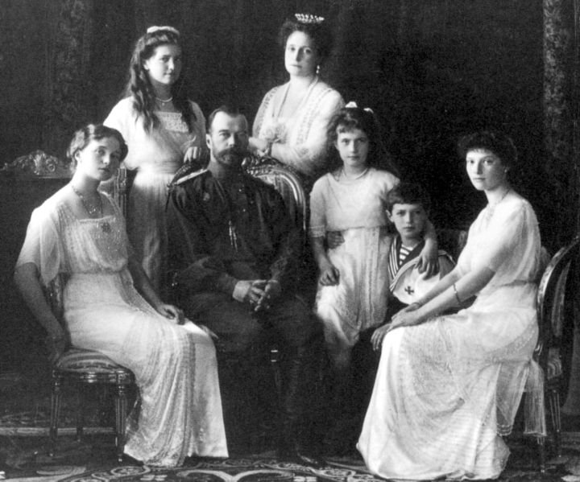
Who do you think these people are?

Slide 10
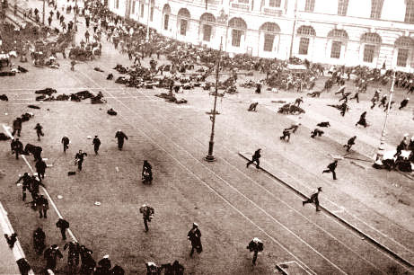
What is going on here?

Slide 11
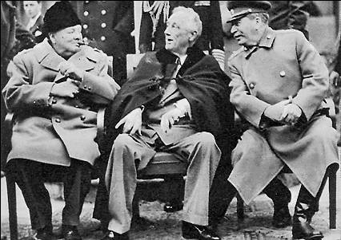
Who are these men and what do you think they are discussing?

Slide 12
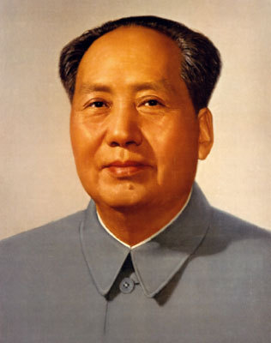
Who is this?

Slide 13
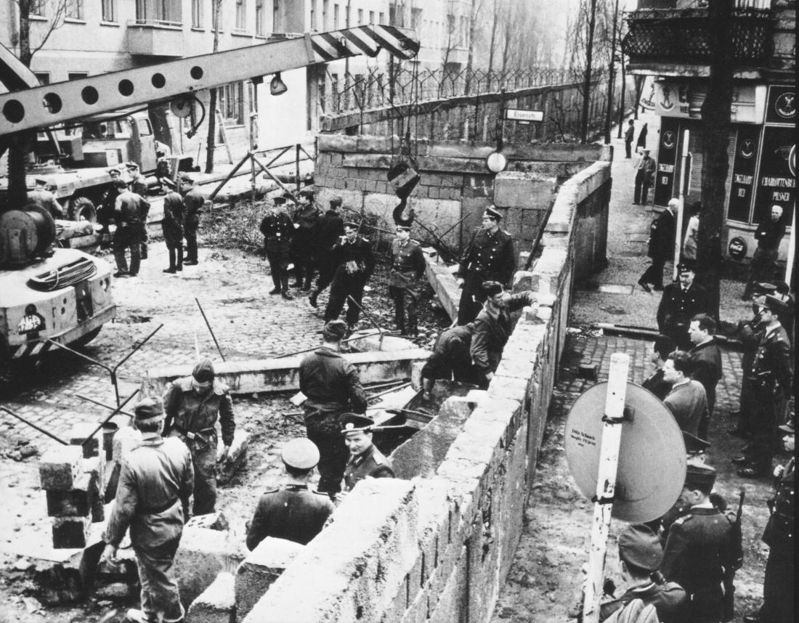
What is happening here?

Slide 14
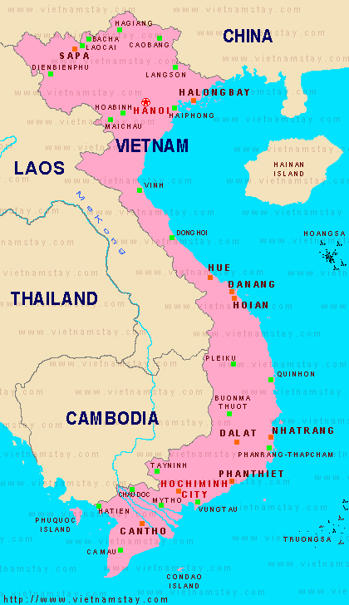
Where is this?

Slide 15
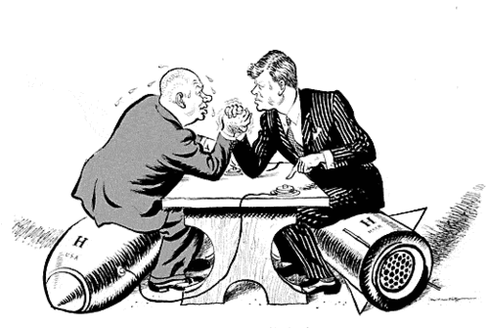
Who are in this cartoon and what are they wrestling about?

Slide 16
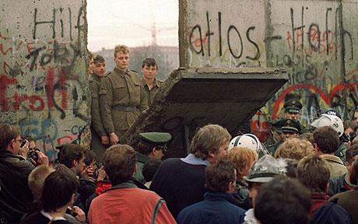
What is happening here?

Slide 17
Areas of Focus
Russian Revolution
Chinese Communist takeover
Post World War II tensions – Cold War
The Vietnam War
The Cold War
Détente
The collapse of the USSR

Slide 18
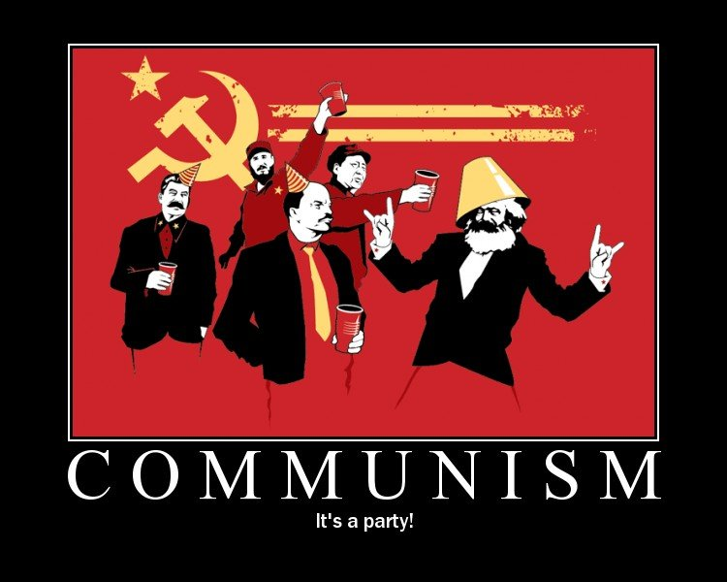
The Link…

Slide 19

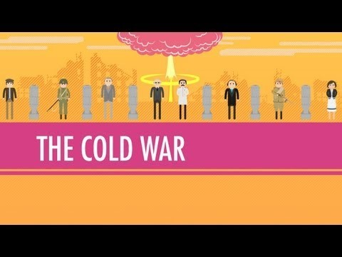
A Summary?
https://www.youtube.com/watch?v=wVqziNV7dGY

