Slide 1
Conflict Continues…
1912-27

Slide 2
The presidency of yuan shikai, 1912-16
The constitutional republic that was set up in 1912 was meant to be a democracy with an elected government, with President Yuan taking the lead. Elections for the parliament took place in 1913 for the National Assembly.
In the elections a new party was set up by Sun Yatsen, and they won the majority. Their party was known as the People’s National Party or Guomindang.
Despite being elected by the people, Yuan Shikai had no interest in sharing power and he quickly started ignoring any decisions that the Assembly made. Yuan clearly wanted to rule as a dictator and not as a democrat.
In January 1914 Yuan dissolved the National Assembly after making himself President for the next 10 years and increasing his power as President. At the same time, he gained huge support from the main European powers. It was in their trading interests to support Yuan and his reign.
By the end of 1914 Yuan was ruling as a dictator and 12 of the 18 provinces were under his control and the military made sure that all followed Yuan.

Slide 3
By 1915 Yuan felt confident enough to make himself Emperor. As per Chinese tradition, a strong military leader who overthrows a weak Emperor should unite China under their rule – this is what Yuan did.
Yuan decided to call his dynasty “The Grand Constitutional Era”. The 27th Dynasty in China’s 2000 year history.
Three groups of people opposed Yuan’s plan. One was Sun Yatsen’s new party, another was a party which consisted of generals in Yuan’s army and the third was the Japanese government which had plans to bring large areas of China under their control.
Early in 1915, the Japanese government presented Yuan with their “Twenty One Demands”. They were demanding control of China’s factories, railways and ports. They threatened war if their demands were not met. The Chinese people were outraged when Yuan met most of these demands. He lost a lot of popularity.
On Christmas Day 1915 the army in a remote part of China rebelled and soon others joined.
Yuan dropped his plans to become Emperor to help keep the peace. 6 months later he died of a stroke.

Slide 4
The Warlords
Yuan Skikai managed to hold China together under his rule, but after his death there was no one strong enough to take his place. As a result of this the central government in Beijing collapsed.
For the next 11 years (1916-27) the other parties set up local governments, with their own leaders. These leaders, all in opposition to each other, were knows as warlords. From 1916, each of these warlords fought each other for the control of China and more kept emerging.
The warlords were only interested in in their own power and wealth and not helping the people in their areas. They imposed high taxes and enlisted peasants into their armies.
Conditions in China were worst when the warlords fought each other to get control of each others provinces. The largest of these Civil Wars took place in 1920 and 1922 and involved over 300,000 soldiers. Both sides fought with great ferocity and cruelity.

Slide 5
The New Revolutionaries
During the Warlords reign of China, membership of Chinese revolutionary movements started to increase.
One such movement was the May Forth movement which was founded on 4 May 1919.
China had joined WW1 in 1917 on the side of the Western Allies. Thousands went to war and many Chinese ports were seized as a result of their involvement.
At the end of the war China was involved in the Paris Peace Conference and one of the main issues on the table was what would happen to the Chinese posts that Germany had possession of. China had expected that the ports would be returned and that Japan would withdraw their 21 demands.
The peace keepers at the end of the war decided that Japan could keep Kiaochow (a very important port) and did nothing to end the 21 demands.

Slide 6
When news of the Paris Peace Conference got to China, protests and demonstrations started. On 4 May 1919 apx. 10,000 Beijing students and school pupils organised a massive demonstration and this quickly spread throughout the country.
Strikes, demonstrations and a boycott of all Japanese goods kept China in a state of unrest for the whole of May 1919.
All of these protests added strength to the ideas of revolution known as “New Tide”. These ideas aimed at getting rid of old fashioned ideas and introduce modern ideas of freedom, equal rights and scientific progress.
The New Tide ideas also wanted to simplify the Chinese language so that uneducated people could read their ideas in magazines and papers.

Slide 7
The Communists and the Guomindang
One set of foreign ideas which made their way into China was Communism.
In 1918 an assistant librarian set up a “Society for the Study of Marxism”, which eventually led to the establishment of a Chinese Communist Party.
Meanwhile Sun Yatsen was reorganising his party and their aims. He announced the parties three principles in 1924. His aim was to unite China under his leadership and make it into a republic free from foreign interference.
National freedom
Democratic government
People’s livelihood
Foreign help was needed against the warlords, but many refused to help. Because of this, Sun turned to Russia for help. Russia sent its most able diplomat to help and with his help, the party was reorganised and well run.
Members of the Guomindany and Chinese Communist Party could be members of both parties and this allowed them to unit under their common aim.
In 1923 the Russian government sent over more agents and create a stronger army to conquer the rest of China.

Slide 8
Chiang Kaishek and the Northern Campaign
In March 1925 Sun Yatsen died of cancer. There were internal party conflicts over who would take over the leadership. While this was happening, Chiang Kaishek became Commander-i-Chief of the new Guomindang Army. The Army had increased in size and had turned out over 500 officers to help conquer China.
In July 1926 Chiang Kaishek began a March to the North at the head of the Guomindang armies. Ahead of him he had political agents who went ahead to get the support of the ordinary people with promises of a national revolution and a new order in China.
There was very little resistance and Chiang and his army gained a lot of territory easier than they thought they would. Many warlords had no choice but to surrender as their armies mutinied and joined the Guomindang.
Propaganda was very strongly used and Chiang had no problem in using bribery in areas he had to in order to gain support.

Slide 9
The Communist-Guoindang Split
As soon as the Communists and Guomindang had gained strong influence and support in north and south China, the alliance split.
As the Guomindang armies approached Shanghai to attack, many workers in the city rebelled against the warlords in the area.
This rebellion was led by communists under Zhou Enlai, who set up a communist council to run the city.
When Chiang Kaishek’s army arrived, they rounded up all the communists they could find on the streets and killed them. Later in the year, Chiang’s men also crushed the Communists in Guangzhou, executing hundreds of then in the streets and forcing thousands more to flee.

Slide 10
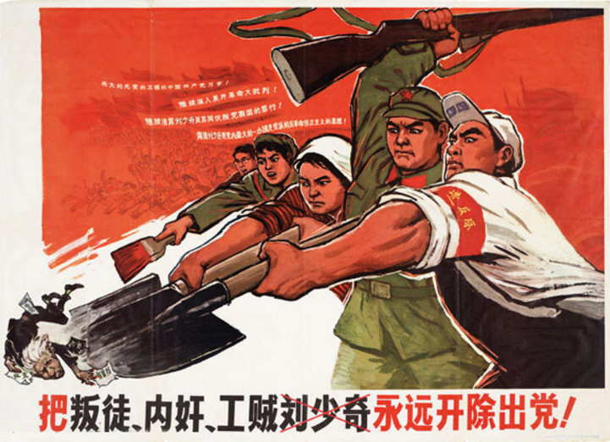
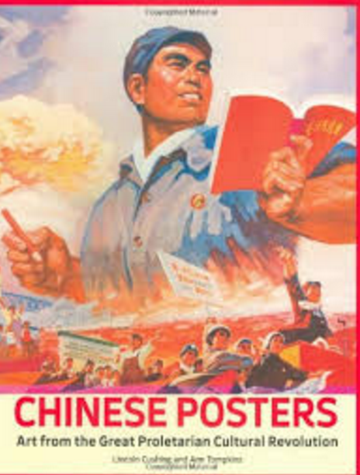

Slide 11
