Slide 1
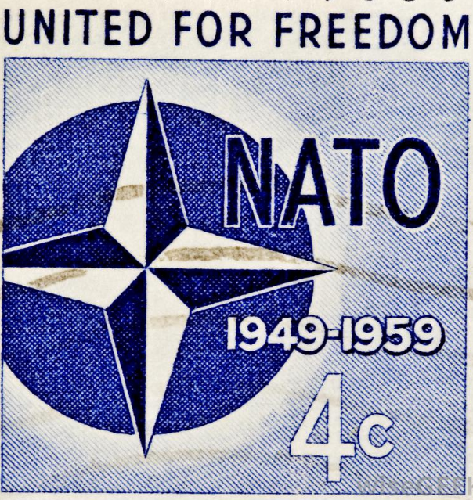
Formation of nato

Slide 2
Introduction
In 1949, the prospect of further Communist expansion prompted the United States and 11 other Western nations to form the North Atlantic Treaty Organization (NATO).
The Soviet Union and its affiliated Communist nations in Eastern Europe founded a rival alliance, the Warsaw Pact, in 1955.
The alignment of nearly every European nation into one of the two opposing camps formalized the political division of the European continent that had taken place since World War II (1939-45).
This alignment provided the framework for the military standoff that continued throughout the Cold War (1945-91).
Notes:
Insert a map of your country.

Slide 3
A divided Europe
Conflict between the Western nations (including the United States, Great Britain, France and other countries) and the Communist Eastern bloc (led by the Union of Soviet Socialists Republics or USSR) began almost as soon as the guns fell silent at the end of World War II (1939-45).
The USSR oversaw the installation of pro-Soviet governments in many of the areas it had taken from the Nazis during the war.
In response, the U.S. and its Western allies sought ways to prevent further expansion of Communist influence on the European continent.
In 1947, U.S. leaders introduced the Marshall Plan, a diplomatic initiative that provided aid to friendly nations to help them rebuild their war-damaged infrastructures and economies.

Slide 4
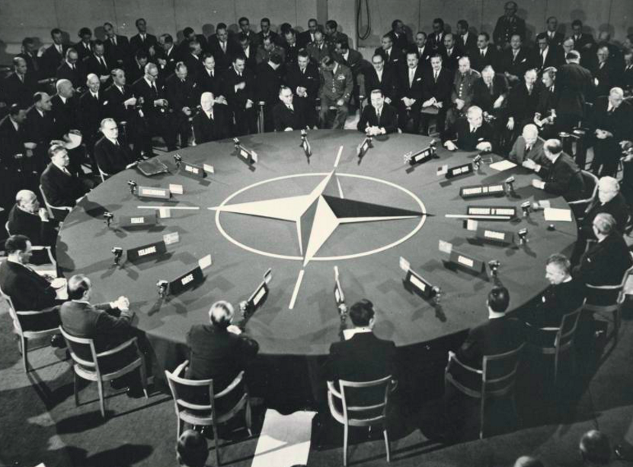
Events of the following year prompted American leaders to adopt a more militaristic stance toward the Soviets.
In February 1948, a coup sponsored by the Soviet Union overthrew the democratic government of Czechoslovakia and brought that nation firmly into the Communist camp.
Within a few days, U.S. leaders agreed to join discussions aimed at forming a joint security agreement with their European allies.
The process gained new urgency in June of that year, when the USSR cut off ground access to Berlin, forcing the U.S., Britain and France to airlift supplies to their sectors of the German city, which had been partitioned between the Western Allies and the Soviets following World War II.

Slide 5
NATO: THE WESTERN NATIONS JOIN FORCES
The discussions between the Western nations concluded on April 4, 1949, when the foreign ministers of 12 countries in North America and Western Europe gathered in Washington, D.C., to sign the North Atlantic Treaty.
It was primarily a security pact, with Article 5 stating that a military attack against any of the signatories would be considered an attack against them all.
When U.S. Secretary of State Dean Acheson (1893-1971) put his signature on the document, it reflected an important change in American foreign policy. For the first time since the 1700s, the U.S. had formally tied its security to that of nations in Europe–the continent that had served as the flash point for both world wars.

Slide 6
The original membership of the North Atlantic Treaty Organization (NATO) consisted of Belgium, Britain, Canada, Denmark, France, Iceland, Italy, Luxembourg, the Netherlands, Norway, Portugal and the United States.
NATO formed the backbone of the West’s military bulwark against the USSR and its allies for the next 40 years, with its membership growing larger over the course of the Cold War era.
Greece and Turkey were admitted in 1952, the Federal Republic of Germany (West Germany) in 1955 and Spain in 1982.
Unhappy with its role in the organization, France opted to withdraw from military participation in NATO in 1966 and did not return until 1995.

Slide 7
WARSAW PACT: THE COMMUNIST ALLIANCE
The formation of the Warsaw Pact was in some ways a response to the creation of NATO, although it did not occur until six years after the Western alliance came into being.
It was more directly inspired by the rearming of West Germany and its admission into NATO in 1955.
In the aftermath of World War I and World War II, Soviet leaders felt very apprehensive about Germany once again becoming a military power–a concern that was shared by many European nations on both sides of the Cold War divide.

Slide 8
In the mid-1950s, however, the U.S. and a number of other NATO members began to advocate making West Germany part of the alliance and allowing it to form an army under tight restrictions.
The Soviets warned that such a provocative action would force them to make new security arrangements in their own sphere of influence, and they were true to their word. West Germany formally joined NATO on May 5, 1955, and the Warsaw Pact was signed less than two weeks later, on May 14.
Joining the USSR in the alliance were Albania, Bulgaria, Czechoslovakia, the German Democratic Republic (East Germany), Hungary, Poland and Romania.
This line-up remained constant until the Cold War ended with the dismantling of all the Communist governments in Eastern Europe in 1989 and 1990.

Slide 9
Like NATO, the Warsaw Pact focused on the objective of creating a coordinated defence among its member nations in order to deter an enemy attack.
There was also an internal security component to the agreement that proved useful to the USSR.
The alliance provided a mechanism for the Soviets to exercise even tighter control over the other Communist states in Eastern Europe and deter pact members from seeking greater autonomy.
When Soviet leaders found it necessary to use military force to put down revolts in Hungary in 1956 and in Czechoslovakia in 1968, for example, they presented the action as being carried out by the Warsaw Pact rather than by the USSR alone.

