Slide 1
The Warsaw Pact
May 1955

Slide 2
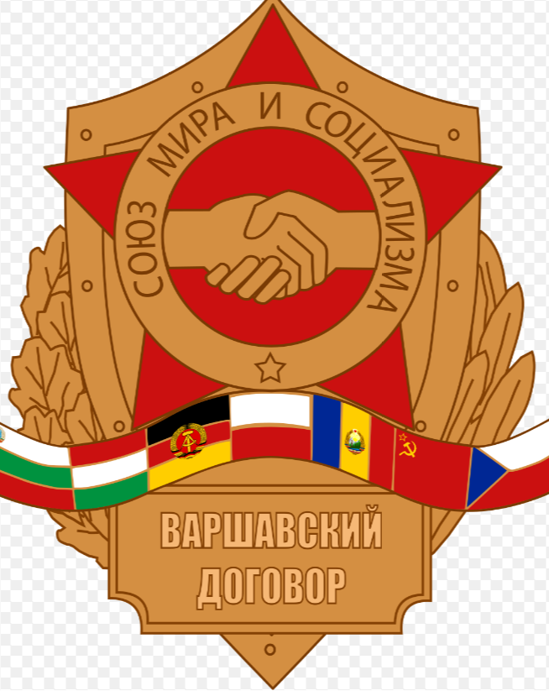
Introduction
The Warsaw Pact was the Soviet Union’s response to West
Germany joining NATOand came into being in May 1955.
The Warsaw Pact, named after the meeting to create it was held in Warsaw, was based throughout the Soviet Bloc and troops in it were used in the ending of the 1968 Czech Revolt.
The Warsaw Pact, officially the ‘Treaty of Friendship, Cooperation and Mutual Assistance’, was obviously very much dominated by the Soviet Union. Soviet made tanks, aircraft and guns were used throughout the Warsaw Pact and the military command was dominated by decisions made in Moscow.

Slide 3
Like NATO, the Warsaw Pact had a political Consultative Committee with a civilian Secretary-General. It also, like NATO, had a commander-in-chief who was the most senior military figure in it. Each member of the Warsaw Pact had to pledge to defend other members if they were attacked.
Whereas the military in NATO was primarily made up of professionals (except for the years when member nations had conscription), the Warsaw Pact very much depended on conscription, whereby young men and women had to serve in their respective country’s military. This reliance on enforcement almost certainly undermined the professional capability of the Warsaw Pact – though its overall military capability was never challenged by NATO as neither side ever fought the other. In the west, the Warsaw Pact was demonised as a massive military monster waiting its chance to attack Western Europe. While this served a useful propaganda purpose, figures acquired by the International Institute for Strategic Studies (IISS) tend to undermine this as the Warsaw Pact had fewer of everything when compared to NATO except fighter aircraft and battle tanks.

Slide 4
IISS claimed that in 1983, the Warsaw Pact had:
1,714,000 ground forces
85 divisions
25,490 main battle tanks
1,787 anti-tank guided weapon launchers
190 submarines
183 anti-submarine submarines
206 capital ships (carriers, cruisers etc)
607 Other naval craft
8,512 fighter aircraft
6,737 anti-aircraft guns and surface to air missiles
NATO, on the other hand, had in 1983:
1,986,000 ground forces
90 divisions
20,722 main battle tanks
2,080 anti-tank guided weapon launchers
182 submarines
385 anti-submarine submarine
314 capital ships (carriers, cruisers etc)
821 Other naval craft
4,338 fighter aircraft
6869 anti-aircraft guns and surface to air missiles

Slide 5
One of the fears NATO had was that the Warsaw Pact probably recognised that her weaponry was more dated than NATO’s and that Moscow, if required to, would fall back on the use of nuclear weapons.
A 1984 report by the Royal Swedish Academy of Sciences estimated that if the Warsaw Pact had attacked NATO bases in West Germany in a ‘limited’ nuclear attack, 10 million West Germans would have been killed and another 10 million would have been injured with most medical facilities put out of operation.
These figures were based on an attack involving 200 kilotons of ground burst bombs – considered a “relatively small attack”.
Papers released by the Polish government after the fall of the Warsaw Pact, showed that plans were in place for such an attack if a swift land based attacked failed.
By the late 1980’s 250 nuclear missiles were based in Poland alone.

Slide 6
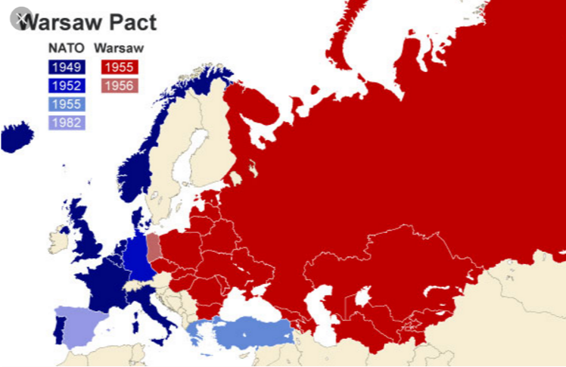
With the collapse of the Cold War at the end of the 1980’s the Warsaw Pact became both unnecessary and unwanted. It ceased to exist on July 1st 1991.
Most former member states of the Warsaw Pact have now joined NATO – the one state that has not is the former Soviet Union.

Slide 7
