Slide 1
Vietnam
Protests and Songs

Slide 2
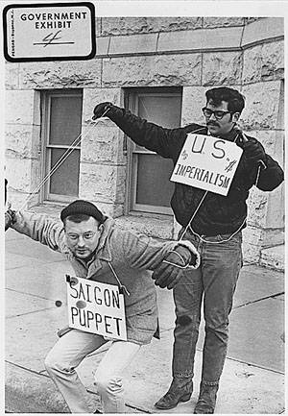

Slide 3
What Do You Know?
Who was protesting?
What kinds of people?
What were they mad about?
Clip of Protests

Slide 4
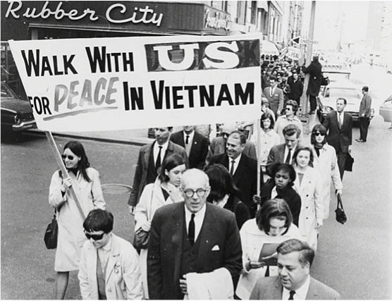

Slide 5
Public Opinion
Vietnam should handle its own business
Against Anti-Communism, Imperialism, and Colonialism
Lack of purpose as well as unjust war
War just dragged through the 60’s

Slide 6
Public Opinion
Draft
Military methods
Protests went global
1965 – over 50% of Americans support war
1967 – only 35% - shift in Congress

Slide 7
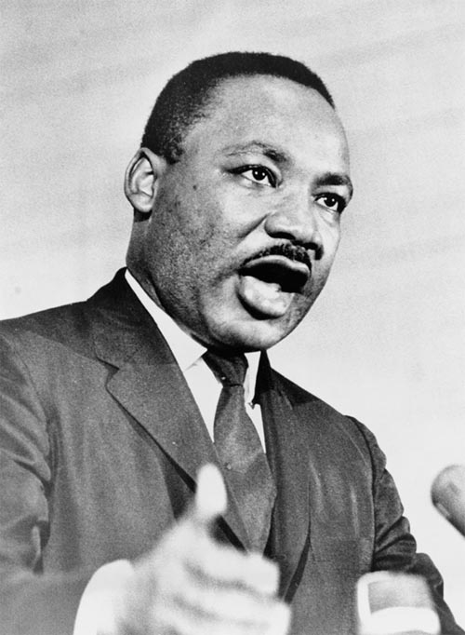
Who Protested?
“We have been repeatedly faced with the cruel irony of watching Negro and white boys on TV screens as they kill and die together for a nation that has been unable to seat them together in the same schools.”

Slide 8
Public Opinion
Not everyone was anti-war
Anger at burning flags and draft cards
“America, Love It or Leave It”
“My Country, Right or Wrong”

Slide 9
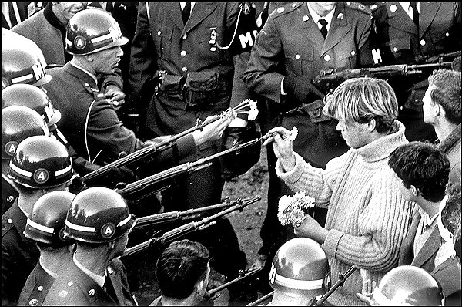
Specific Protests
August 1968 – Democratic National Convention
10,000 protestors
Police brutality caught on tape

Slide 10
Specific Protests
By 1969 – peace movement became more mainstream
Clergy, trade unionists, veterans established October 15 1969 as a peaceful demonstration day “Moratorium Day”
November 1969 – 250,000 in Washington D.C. for largest
Vietnam Veterans in April 1971 – threw down medals

Slide 11
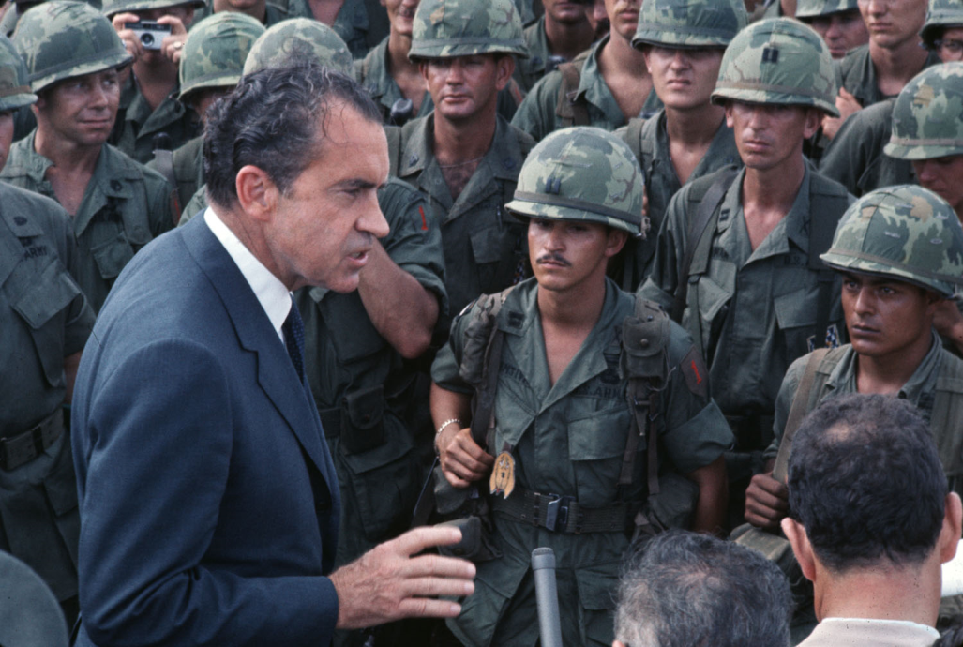
Richard Nixon
"Now, I understand that there has been, and continues to be, opposition to the war in Vietnam on the campuses and also in the nation. As far as this kind of activity is concerned, we expect it, however under no circumstances will I be affected whatever by it.“ – Richard Nixon 1969

Slide 12
Kent State
Tin soldiers and Nixon coming,
We're finally on our own.
This summer I hear the drumming,
Four dead in Ohio.
Gotta get down to it
Soldiers are cutting us down
Should have been done long ago.
What if you knew her
And found her dead on the ground
How can you run when you know?

Slide 13
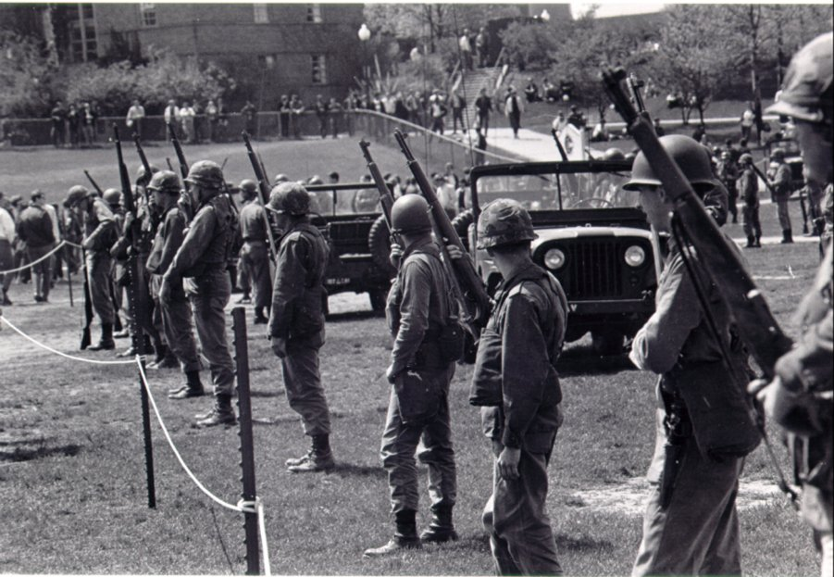
Kent State

Slide 14
Kent State
May 1- May 4 1970 Reaction - Cambodia
Student protests
Set ROTC building on fire
National Guard called
Shootings – 4 Dead

Slide 15
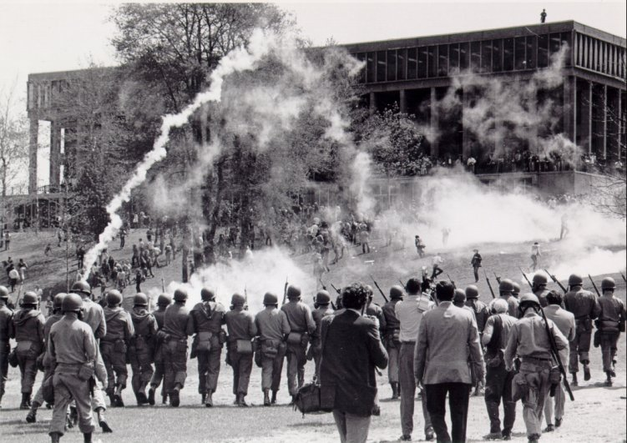

Slide 16
Protest Songs
More songs from counterculture
Pick a song, Read the Lyrics
Take notes to turn in
What specifically is being discussed?
Connect lyrics to what we have studied
Pick out 2 Lines that you like

Slide 17
REM – Orage Crush
Orange Crush (1988) – This song by the alternative rock band R.E.M., was in reference to the government’s use of the controversial herbicide known as Agent Orange to remove trees and dense foliage that the Viet Cong would use during the Vietnam War.
https://youtu.be/_mSmOcmk7uQ

Slide 18
Jim Morrison – The Unknown Shoulder
The Unknown Soldier (1968) – This anti-war song was Jim Morrison and the Doors contribution to their opposition to the Vietnam War. The Unknown Soldier is likely in reference to the Tomb of the Unknowns military memorial at Arlington Cemetery and the song contained a sequence that resembles a military funeral honours ceremony complete with a firing party
https://www.youtube.com/watch?v=0oW9GLgsa8s

Slide 19
Bruce Springsteen - Born in the USA
(1984) – The Bruce Springsteen single from the biggest selling album of 1985 was written to be a song about the troubles of a working class man forced into the Vietnam War but was largely considered to be a patriotic song. It was so popular that the Reagan administration asked to use it as part of the reelection campaign but Springsteen, a strong liberal, nixed the idea.
https://www.youtube.com/watch?v=EPhWR4d3FJQ

Slide 20
Bob Dylan - Blowing in the Wind
(1963) - This song was written and recorded by a then 21-year-old Bob Dylan as the United States escalated their involvement in the Vietnam War. The song, which gained larger prominence when it was re-recorded by the folk trio, Peter, Paul and Mary, became one of the most famous protest songs to come out of the 60s as well as an anthem for the African-American Civil Rights Movement
https://www.youtube.com/watch?v=vWwgrjjIMXA

